Slide 1
Revenue Recognition
Taral Pathak

Slide 2
Introduction
Revenue recognition is mainly concerned with the timing of recognition of revenue in the statement of profit and loss of an enterprise

Slide 3
Basic principles: Sale of goods
The key criterion for determining when to recognize from a transaction involving sale of goods is that the seller has transferred the property in the goods to the buyer for a consideration.
The transfer of property coincides with transfer of significant risks and rewards of ownership to the buyer.
No significant uncertainty exists regarding the amount of consideration that will be derived from the sale of goods.

Slide 4
Basic principles: Rendering of services
Revenue from service transactions is usually recognized as the service is performed, either by
  The proportionate completion method or
  Completed service contract method
Proportionate completion method: When the performance consists of execution of more than one act. Revenue is recognized proportionately by reference to the performance of each act.
The revenue recognized under this method would be determined on the basis of contract value, associated costs, number of acts or other suitable basis.

Slide 5
Basic principles: Rendering of services
For practical purposes, when the services are provided by an indeterminate number of acts over a specified period of time, revenue is recognized on a straight line basis over the specified period unless there is evidence that some other method better represents the pattern of performance

Slide 6
Basic principles: Rendering of services
Completed service contract method: Performance consists of the execution of a single act. Alternatively, services are performed in more than a single act, and the service yet to be performed is so significant in relation to the transaction taken as a whole that performance cannot be deemed to have been completed until the execution of those acts.
Then revenue is recognized when the sole or the final act takes place and the service becomes chargeable

Slide 7
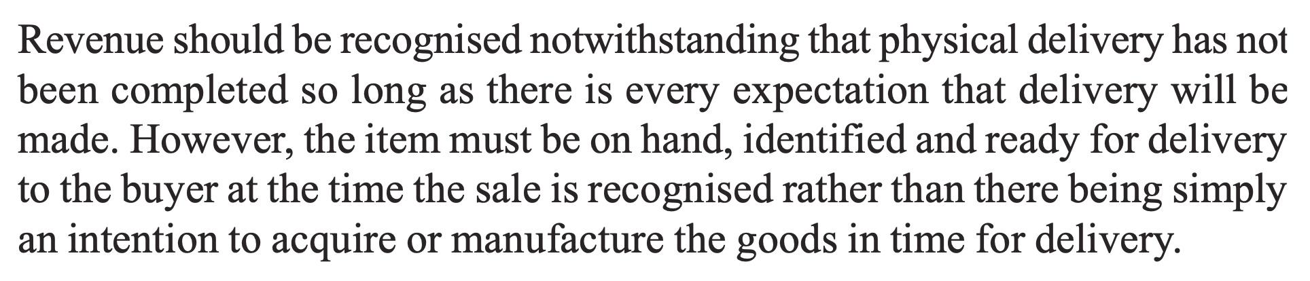
Case-Sale of goods

Slide 8
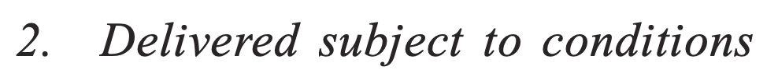
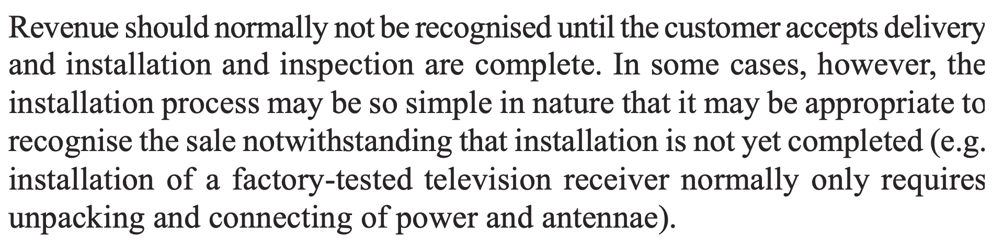
Case-Sale of goods

Slide 9
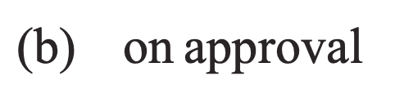
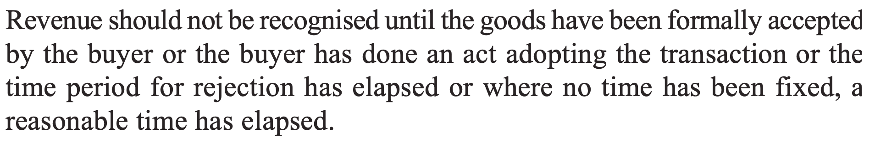
Case-Sale of goods

Slide 10
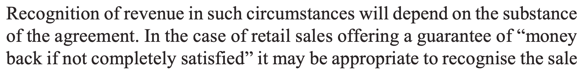
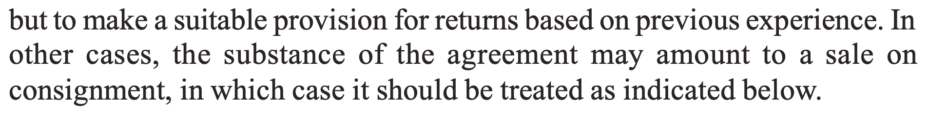
Case-Sale of goods

Slide 11
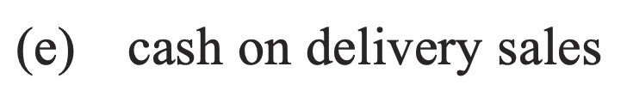
Case-Sale of goods

Slide 12
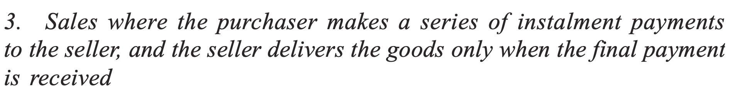
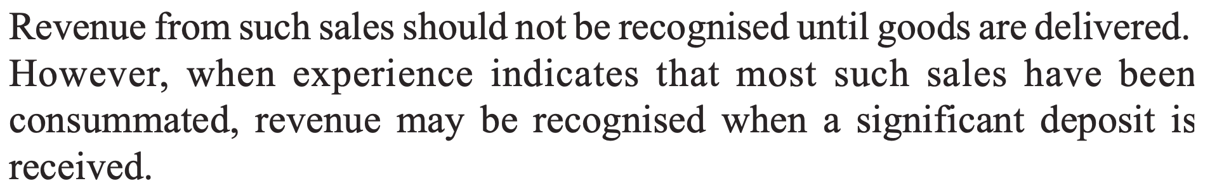
Case-Sale of goods

Slide 13
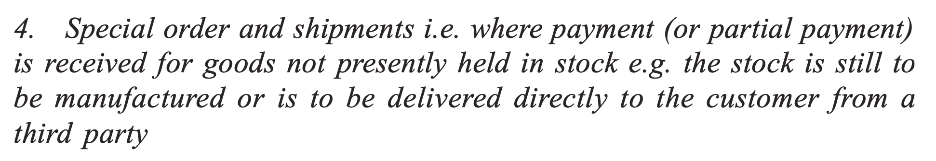
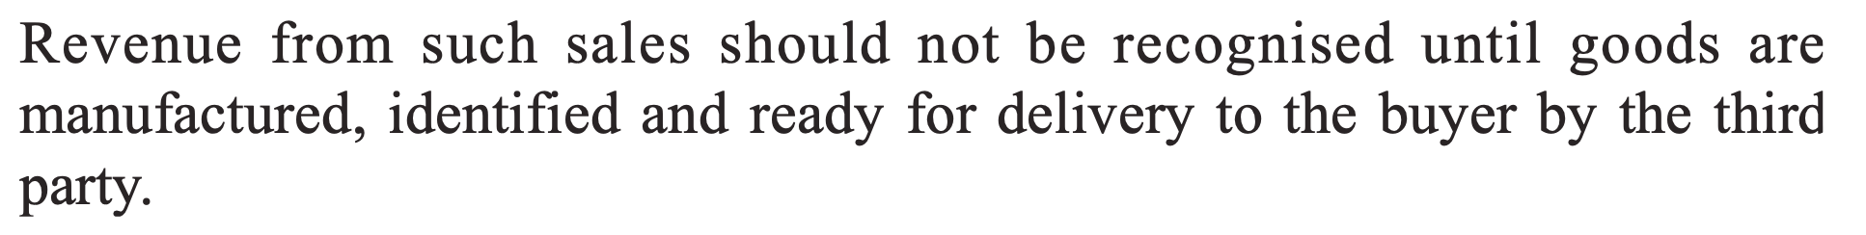
Case-Sale of goods

Slide 14
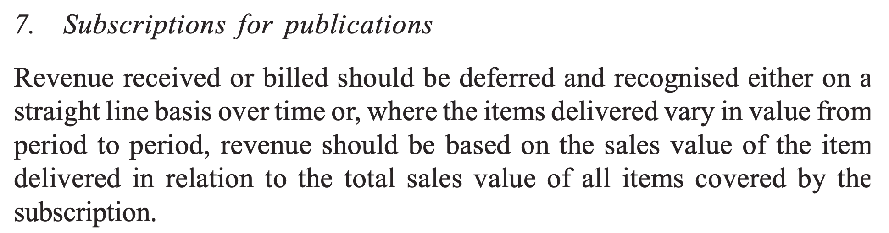
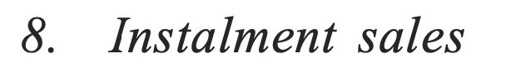
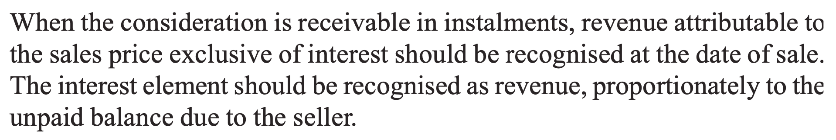
Case-Sale of goods

Slide 15
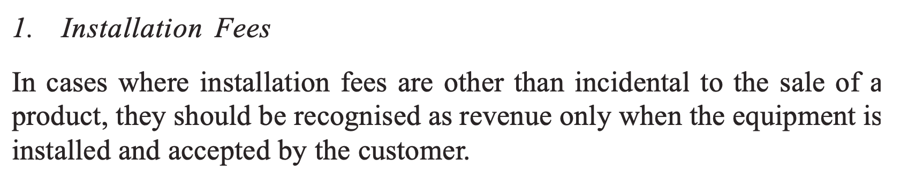
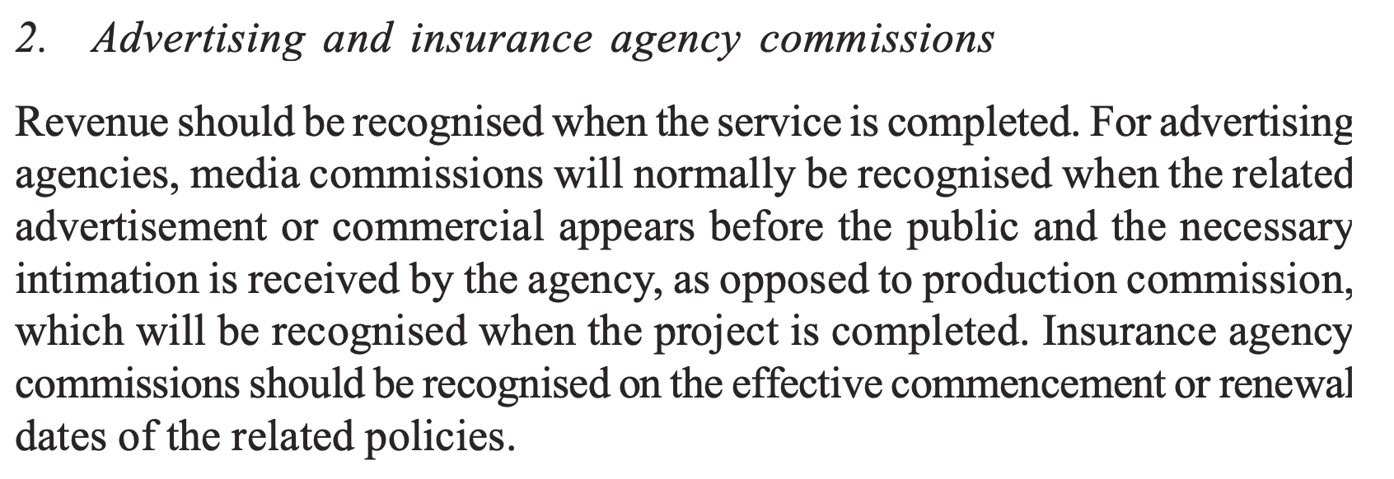
Case-Rendering of services

Slide 16
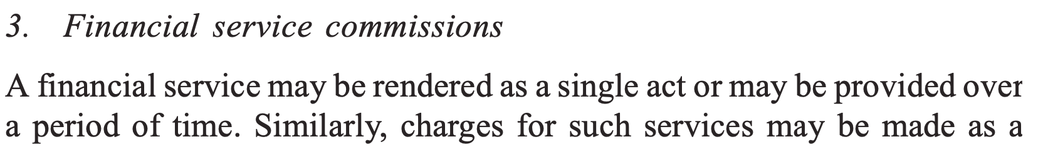
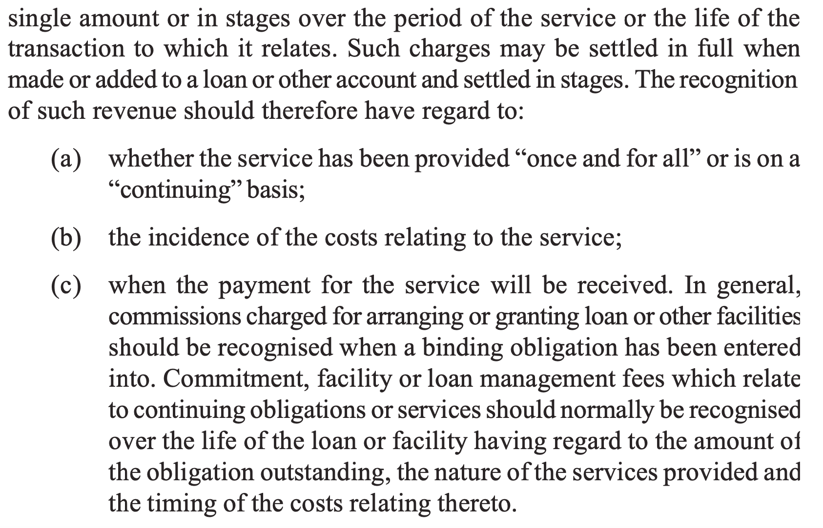
Case-Rendering of services

Slide 17
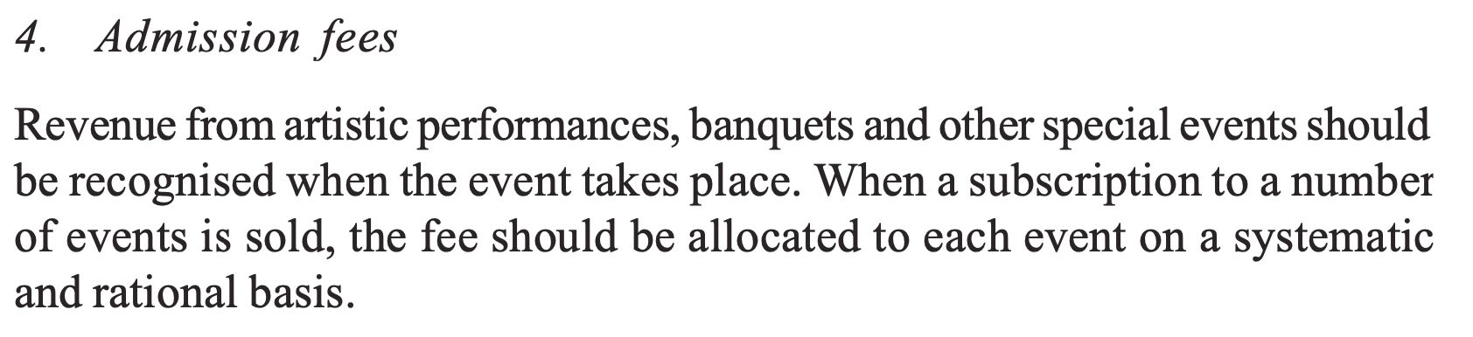
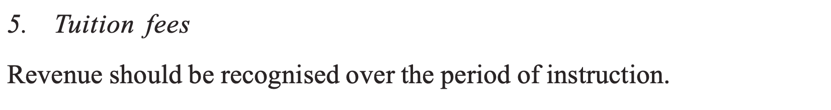
Case-Rendering of services

Slide 18
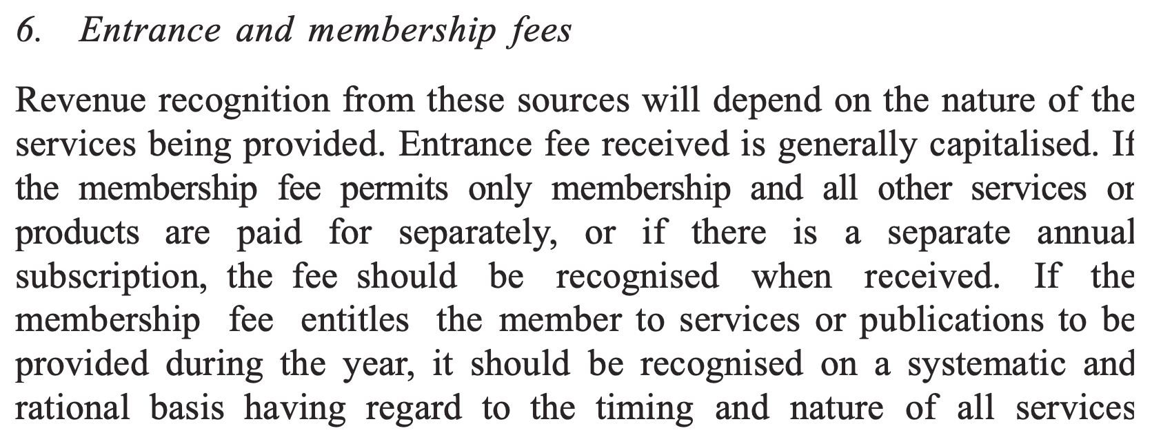
Case-Rendering of services

